Slide 1
Financial Markets and Securities Session 3 Risk and Return

Slide 2
Rates of Return

Slide 3
Rates of Returns
One period investment: regardless of the length of the period.
Holding period return (HPR):
HPR = where
P_{S} = Sale price (or P₁)
P_{B} = Buy price ($ you put up) (or P₀)
CF = Cash flow during holding period
Dividend yield or Coupon payment
Dividend at the end of the period
Q:Why use % returns at all?
Q: What are we assuming about the cash flows in the HPR calculation?
[P_{S} - P_{B} + CF] / P_{B}
Notes:
Q: % returns, removes size of investment concerns
Q: CF should occur at the end of the period, otherwise missing reinvestment of those cash flows. Or the CF could be the future value of any interim cashflows.

Slide 4
Annualizing HPRs
HPR/n
[(1+HPR)^{1/n}]-1
Q: Why would you want to annualize returns?
1. Annualizing HPRs for holding periods of greater than one year:
Without compounding (Simple or APR): HPR_{ann} =
With compounding: EAR
HPR_{ann} =
where n = number of years held

Slide 5
Ex-Post (Past) Returns
(1+0.3333)^{1/2} - 1 = 15.47%
An example: Suppose you buy one share of a stock today for $45 and you hold it for two years and sell it for $52. You also received $8 in dividends at the end of the two years.
(PB = $45, PS = $52, CF = $8):
HPR = (52 - 45 + 8) / 45 = 33.33%
HPR_{ann} = 0.3333/2 = 16.66%
The annualized HPR assuming annual compounding is (n=2 ):
HPR_{ann} =
Notes:
(A good rule is to carry all calculations to at least four decimal places).

Slide 6
Measuring Past Returns
Finding the average HPR for a portfolio of assets for a given time period:
where V_{I} = amount invested in asset I,
J = Total # of securities
and TV = total amount invested;
thus V_{I}/TV = percentage of total investment invested in asset I
Notes:
(A good rule is to carry all calculations to at least four decimal places).

Slide 7
Measuring Past Returns
For example: Suppose you have $1000 invested in a stock portfolio in September. You have $200 invested in Stock A, $300 in Stock B and $500 in Stock C. The HPR for the month of September for Stock A was 2%, for Stock B the HPR was 4% and for Stock C the HPR was - 5%.
The average HPR for the month of September for this portfolio is:
-0.9%
Notes:
(A good rule is to carry all calculations to at least four decimal places).

Slide 8
Real vs. Nominal Rates
Fisher effect: Approximation
real rate ≈ nominal rate - inflation rate
r_{real} ≈ r_{nom} - i
Example r_{nom} = 9%, i = 6%
r_{real} ≈ 3%
Fisher effect: Exact
r_{real} = or
r_{real} =
r_{real} =
The exact real rate is less than the approximate real rate.
r_{real} = real interest rate
r_{nom} = nominal interest rate
i = expected inflation rate
[(1 + r_{nom}) / (1 + i)] – 1
(r_{nom} - i) / (1 + i)
(9% - 6%) / (1.06) = 2.83%
Notes:
One issue we have ignored until now is the effect of inflation on our investments.
The nominal rate is the rate we have been calculating. Not adjusted for inflation. To adjust for inflation we must calculate the real rate of return. At first glance you might think we just need to subtract the inflation rate from the nominal rate, but this is not correct.
To get correct answer we must use the Fisher effect calculation.
1+r = 1+R/1+i which can be converted to r=(R-i)/(1+i)

Slide 9
Risk and Risk Premiums

Slide 10
But how do we know the return?
We can have expectation on the return, but we cannot be sure, and we also have a certain probability.
Scenario analysis:
Statistical observation of the possible returns
Create a list of possible outcomes, “States of Nature.”
Specify the likelihood of each state to occur p(s)
What is the return if the state occurs r(s)
Notes:
Scenario analysis: Create a list of possible outcomes s, “States of Nature.”
Specify the likelihood of each state to occur p(s)
What is the return if the state occurs r(s)
Statistical observation of the possible returns

Slide 11
Measuring Risk
What is risk?
How can it be measured?
Variance: Average value of squared deviations from mean. A measure of volatility.
Standard Deviation: Square root of variance. Also a measure of volatility.
The extent of uncertainty
The chances that the actual outcome will be very different from expectations
The variance of a probability distribution
Casually: threat of a negative outcome
People don’t worry about positive deviations
Notes:
16
Variance - Average value of squared deviations from mean. A measure of volatility.
Standard Deviation – Square root of variance. A measure of volatility.

Slide 12
Risk and return
The quantification of risk and return is a crucial aspect of modern finance. It is not possible to make “good” (i.e., value-maximizing) financial decisions unless one understands the relationship between risk and return.
Rational investors like returns and dislike risk.
Consider the following proxies for return and risk:
Expected return - weighted average of the distribution of possible returns in the future.
Variance of returns - a measure of the dispersion of the distribution of possible returns in the future.

Slide 13
Variance
Average deviation from the expected value (or the average of the squared differences from the Mean)
Standard deviation = volatility (in finance)
In finance, volatility is a measure for variation of price of a financial instrument over time.
The spread of the distribution
Diversity among the extreme outcomes
Large variance
=> Large chance of the extreme outcome(s) occurring
=> The decision is rather risky

Slide 14
Scenario or Subjective Returns
Subjective expected returns
E
Σ
(
r
)
=
p
(
s
)
r
(
s
)
s
E(r) = Expected Return
p(s) = probability of a state
r(s) = return if a state occurs1 to s states
Notes:
Scenario analysis: Create a list of possible outcomes s, “States of Nature.”
Specify the likelihood of each state to occur p(s)
What is the return if the state occurs r(s)
Statistical observation of the possible returns

Slide 15
Measuring Variance or Dispersion of Returns
a. Subjective or Scenario
Variance
σ = [σ²]^{1/2}
E(r) = Expected Return
p(s) = probability of a state
r_{s} = return in state “s”

Slide 16
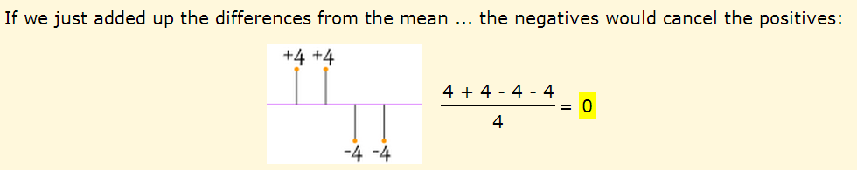
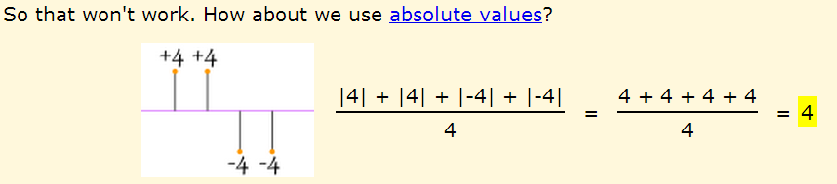
Why square the differences?

Slide 17
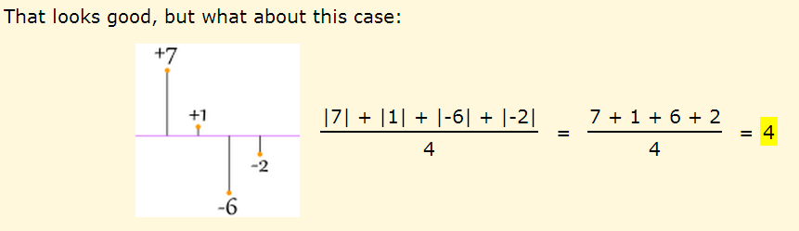
Why square the differences?

Slide 18
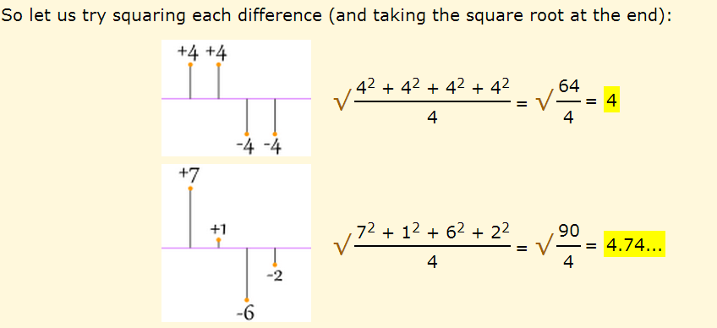
Why square the differences?

Slide 19
Numerical Example
(.2)(-0.05) + (.5)(0.05) + (.3)(0.15) = 6%
σ² = [(.2)(-0.05-0.06)² + (.5)(0.05- 0.06)² + (.3)(0.15-0.06)²]
σ² = 0.0049%²
σ = [ 0.0049]^{1/2} = .07 or 7%
State Prob. of State Return
1 .2 - .05 Weak
2 .5 .05 Normal
3 .3 .15 Good
E(r) =

Slide 20
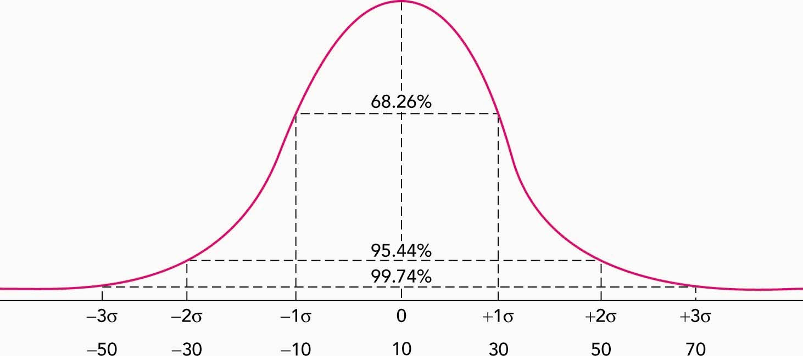
Normal Distribution
σ measures deviations above the mean as well as below the mean.
Returns > E[r] may not be considered as risk, but with symmetric distribution, it is ok to use σ to measure risk.
I.E., ranking securities by σ will give same results as ranking by asymmetric measures such as lower partial standard deviation.
Risk is the possibility of getting returns different from expected.
E[r] = 10%
σ = 20%
Average = Median
Notes:
The normal distribution is symmetric around the mean. In a normal distribution the mean + or – one standard deviation will encompass approximately 68% of the possible outcomes. Since this is a normal distribution the mean and the median outcome will be the same.
Talk about std dev as risk measure. Risk not really from returns > E[r], but symmetric so ok to use std dev. I.E., ranking securities by standard dev will give same results as ranking by lower partial standard dev.
Signifficant level

Slide 21
Characteristics of Probability Distributions
Mean: __________________________________ _
Median: _________________
Variance or standard deviation:
Skewness:_______________________________
Leptokurtosis: ______________________________
Arithmetic average & usually most likely
Middle observation
Dispersion of returns about the mean
Long tailed distribution, either side
Too many observations in the tails
If a distribution is approximately normal, the distribution is fully described by _____________________
Characteristics 1 and 3
Notes:
mode = most frequent observation
These are some major characteristics of distributions.
The mean is the average return we expect given all of the different possible outcomes.
Variance and standard deviation give us a quantitative measurement of the level of dispersion of the possible outcomes.
And skewness tells us about how evenly the possible outcomes are distributed around the mean. Skewed distributions have a mean that is different than the median.
If return distributions are close to “normal”, mean and variance will do a good job at describing the expected return and the risk premium of an investment.

Slide 22
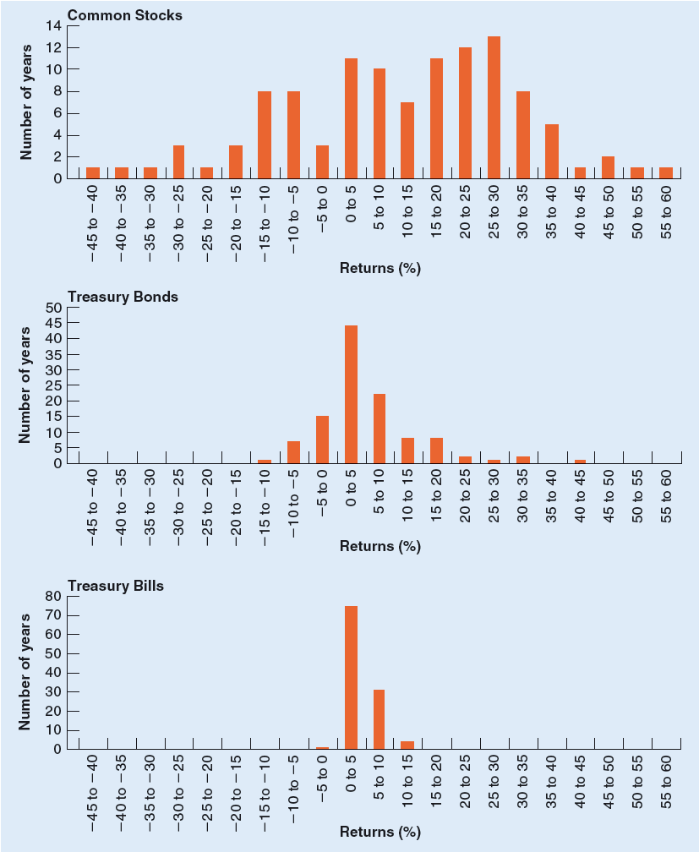
Histogram of Returns
What is the relationship between the volatility of these securities and their expected returns?

Slide 23
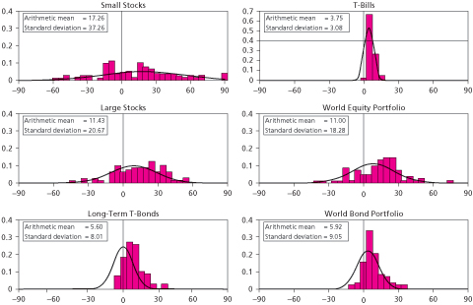
Frequency distrib. of an. HPRs
Notes:
Forward looking purpose: Use Arithmetic Mean.
Note relationship between means and standard deviations and the standard deviation of a large stock portfolio.
Ask, which is the most risky and which is he least risky?
Note apparent deviations from normality in small stocks particularly.

Slide 24
The Risk/Return Trade-off
In the investing world, the dictionary definition of risk is the chance that an investment's actual return will be different than expected. Technically, this is measured in statistics by standard deviation. Risk means you have the possibility of losing some, or even all, of our original investment.
A common misconception is that higher risk equals greater return. The risk/return tradeoff tells us that the higher risk gives us the possibility of higher returns. There are no guarantees. Just as risk means higher potential returns, it also means higher potential losses.

Slide 25
Asset Allocation Across Risky and Risk Free Portfolios

Slide 26
Allocating Capital Between Risky & Risk-Free Assets
Possible to split investment funds between safe and risky assets
Risk free asset rf : proxy; ________________________
Risky asset or portfolio r_{p}: _______________________
Example. Your total wealth is $10,000. You put $2,500 in risk free T-Bills and $7,500 in a stock portfolio invested as follows:
Stock A you put ______
Stock B you put ______
Stock C you put ______
T-bills or money market fund
risky portfolio
$2,500
$3,000
$2,000
$7,500
Notes:
What percentage of your holdings are in the risk-free asset? 25%. What percent are in the risky asset 75%. Your entire portfolio includes both risky and risk-free assets

Slide 27
Allocating Capital Between Risky & Risk-Free Assets
Weights within risky asset
W_{A} =
W_{B} =
W_{C} =
The complete portfolio includes the riskless
investment and r_{p}.
$2,500 / $7,500 = 33.33%
$3,000 / $7,500 = 40.00%
$2,000 / $7,500 = 26.67%
100.00% of the risky assets
W_{rf} = ; W_{rp} = In the complete portfolio
W_{A} = 0.75 x 33.33% = 25%;
25%
75%
W_{B} = 0.75 x 40.00% = 30%
W_{rf} = 25%
W_{C} = 0.75 x 26.67% = 20%;
Notes:
How much should be invested in the risky asset? 10%, 50%, 100%, 110%? 110 is taking a loan and investing (on margin)
Assuming the risky portfolio has been optimized, Depending on your level of risk you must merely choose between your weights of the risk free and the risky portfolio.

Slide 28
Example
E(r_{f}) = 5%
σ_{rf} = 0%
E(r_{p}) = 14%
σ_{rp} = 22%
y = % in r_{p}
(1-y) = % in rf= 25%
Notes:
Rf is the risk-free rate of return. Here it is 5%. Since this return is truly risk free the standard deviation of the risk-free asset is 0.
Expected return on the risky portfolio is 14%. With a standard deviation of 22%
Y is the percentage of your total wealth in the risky portfolio.

Slide 29
Expected Returns for Combinations
E(r_{C}) =
yE(r_{p}) + (1 - y)r_{f}
yσ_{rp} + (1-y)σ_{rf}
σ_{c} =
E(r_{C}) =
Return for complete or combined portfolio
0.75
For example, let y = ____
E(r_{C}) =
E(r_{C}) = .1175 or 11.75%
(.75 x .14) + (.25 x .05)
σ_{C} = yσ_{rp} + (1-y)σ_{rf}
σ_{C} = (0.75 x 0.22) + (0.25 x 0) = 0.165 or 16.5%
Notes:
The percentage in the risky portfolio times the expected return of the risky portfolio.
Plus the percentage in the risk-free times its return.

Slide 30
Complete portfolio
E(r_{c}) = yE(r_{p}) + (1 - y)rf
σ_{c} = yσ_{rp} + (1-y)σ_{rf}
linear
combinations
This is NOT generally the case for the σ of combinations of two or more risky assets.
Varying y results in E[r_{C}] and σ_{C} that are ______ ___________ of E[rp] and rf and σ_{rp} and σ_{rf} respectively.
Notes:
The percentage in the risky portfolio times the expected return of the risky portfolio.
Plus the percentage in the risk-free times its return.

Slide 31
Combinations Without Leverage
E(r_{c}) = yE(r_{p}) + (1 - y)rf
y = .75
E(r_{c}) =
y = 1
E(r_{c}) =
y = 0
E(r_{c}) =
(.75)(.14) + (.25)(.05) = 11.75%
75(.22) = 16.5%
(1)(.14) + (0)(.05) = 14.00%
1(.22) = 22%
0(.22) = 0%
(0)(.14) + (1)(.05) = 5.00%
Since σ_{rf} = 0
σ_{c}= y σ_{p}
If y = .75, then
σ_{c}=
If y = 1
σ_{c}=
If y = 0
σ_{c}=

Slide 32
Capital Allocation Line
E(r)
E(r_{p}) = 14%
E(r_{p}) = 11.75%
P
y = 1
y =.75
r_{f} = 5%
F
y = 0
0
16.5%
22%
σ
Notes:
Expected return on the vertical axis, and standard deviation of total portfolio on the horizontal axis. With all of your money in the risk free you will have 7% return and no standard deviation. With all in the risky asset will have 15 expected return and 22% standard deviation. Can move along this line.
High risk is connected to higher return!!!!

Slide 33
P or combinations of P & Rf offer a return per unit of risk of 9/22.
E(r)
CAL
(Capital
Allocation
Line)
P
E(r_{p}) = 14%
E(r_{p}) -
r_{f} = 9%=
risk premium
) Slope = 9/22
r_{f} = 5%
F
0
σ_{rp}
= 22%
σ
Notes:
This is the complete Capital Allocation Line.
The slope says that for an increase in return of 8% we will have an increase in the SD of our portfolio by 22%. The risk premium is also shown.

Slide 34
Risk Aversion and Allocation
Lower levels of risk aversion lead investors to choose larger proportions of the portfolio of risky assets
Willingness to accept high levels of risk for high levels of returns would result in leveraged combinations
y = 1.5
y = 0
Greater levels of risk aversion lead investors to choose larger proportions of the risk free rate

Slide 35
Active vs. Passive Management
Active Management
Finding undervalued securities
Timing is essential
Passive Management
No attempt to find undervalued securities
No attempt to time
Holding an efficient portfolio

Slide 36
A Passive Strategy
Investing in a broad stock index and a risk free investment is an example of a passive strategy.
The investor makes no attempt to actively find undervalued strategies nor actively switch their asset allocations.
The CAL that employs the market (or an index that mimics overall market performance) is called the Capital Market Line or CML.

Slide 37
Risk Premiums, Risk Aversion
Risk-free rate: The rate of return that can be earned with certainty
Risk premium: An expected return in excess of that on risk-free securities.
Excess return: Rate of return in excess of the Treasury-bill rate.
Risk aversion: Reluctance to accept risk.

Slide 38
Risk Premium & Risk Aversion
E[r_{asset}] – rf
The risk free rate is the rate of return that can be earned with certainty.
The risk premium is the difference between the expected return of a risky asset and the risk-free rate.
Excess Return or Risk Premium_{asset} =
Risk aversion is an investor’s reluctance to accept risk.
How is the aversion to accept risk overcome?
By offering investors a higher risk premium.

Slide 39
Thank you for the attention!
Any Questions?

